Slide 1
CONFIDENTIALITY PRESERVING DATA STORAGE IN CLOUD
GUIDED BY
PROF. SUNEETA MOHANTY
SUBMITTED BY
SANDEEP KUMAR(1606135)
ABHILEKH TALUKDAR(1606164)

Slide 2
PROBLEM STATEMENT
With the development of cloud storage system and its application in complex environment,its data security is in jeopardy.
Node crashes or external invasion may lead to partial or complete data loss.
Data node crashes or external invasion are likely to lead to incomplete data.
The user cannot be promptly informed about the change because the cloud service provider deliberately concealed the data loss or other factors.
Users are concerned about the confidentiality of their data,which cannot be guaranteed.
If strong confidentiality is implemented, then portability of data is compromised. On the other hand, if weak confidentiality is implemented, then data security is compromised.

Slide 3
Data should be readily available whenever the user requests it.
There is a need for reliable and efficient method to ensure portability and fault tolerance, which is not achieved through strong confidentiality.

Slide 4
In our proposed system, it is assumed that the data to be uploaded is done from a trusted server.
The layer of security provided encrypts the whole data using Rabin Cryptosystem.
The security of the encrypted data, is further enhanced by slicing the entire data into multiple parts which are rearranged and kept in specific nodes in different data centers in a manner that each node contains 2/3rd of the entire data and on combination of minimum two nodes, we get the entire data.
This arrangement is beneficial as, in case any data node gets crashed and is affected by external invasion, nothing or least effect is caused to the entire data and the middleware can even retrieve back the data from different backend storage layers.

Slide 5
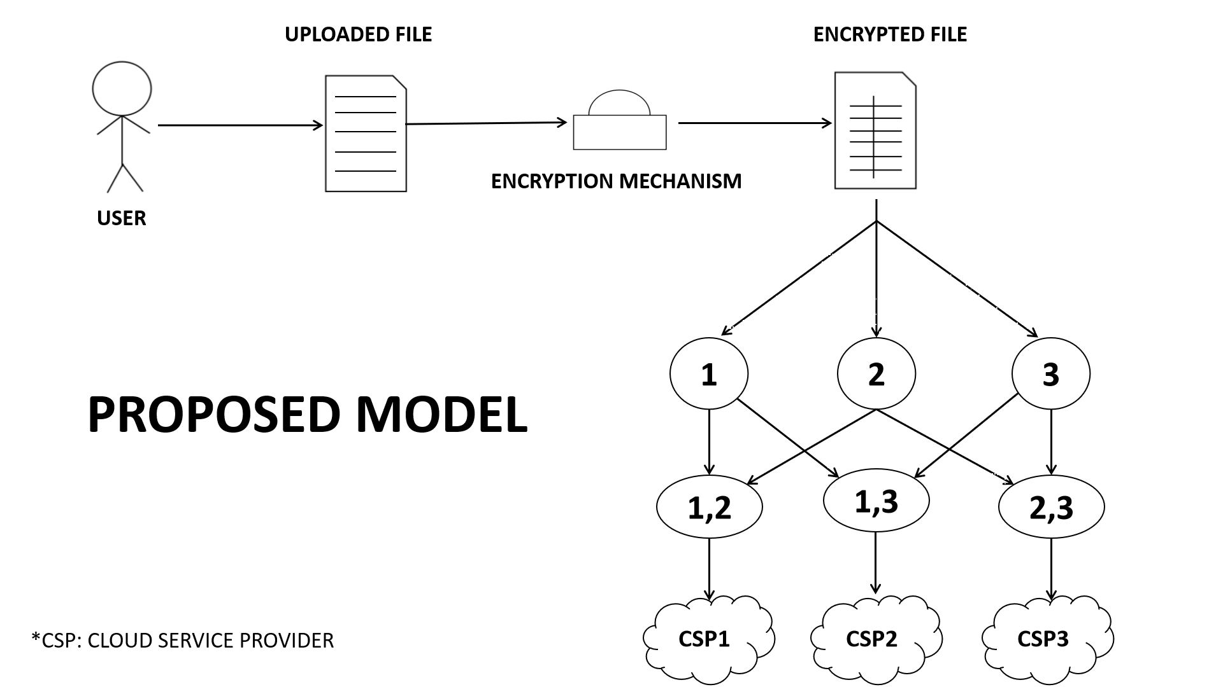

Slide 6
Proposed Model
User uploads the file that he needs to store.
The system encrypts the file using an algorithm.
The encrypted file is sliced into three parts.
Copies of the data slices are made.
Slices are grouped together so that they form unique combinations and stored in backend storage layers.
Indexing table is maintained in a database which stores the information about the locations of the different slices.
Using this table the file is regenerated.

Slide 7
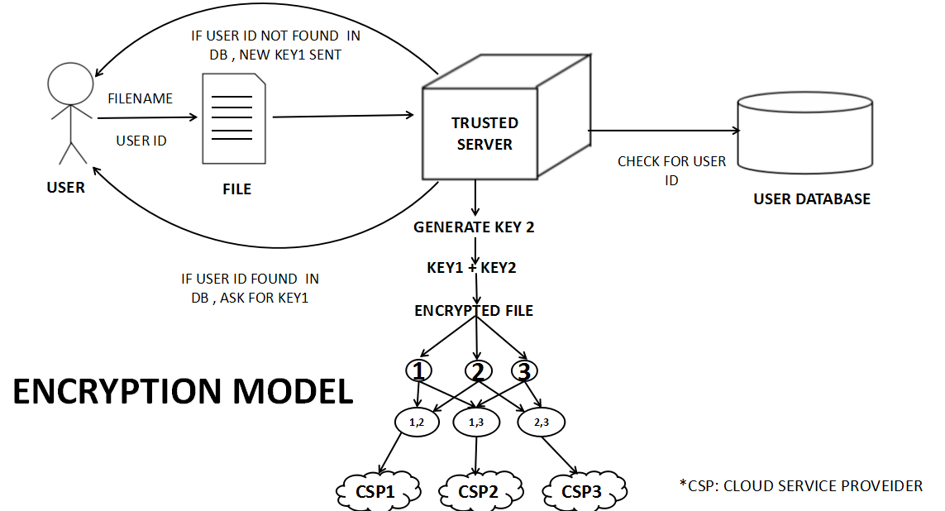
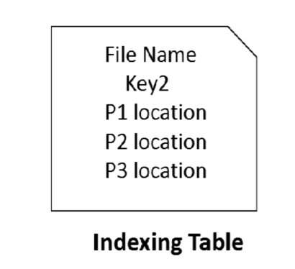


Slide 8
Encryption Model
The data inside the file is encrypted using Rabin cryptosystem as a base.
The user is prompted to enter his unique key.
If the user fails to provide his unique key, a new account is created and system provides him with a randomly generated unique key(k1).
The system generates another private key(k2).
The data is encrypted using combination of k1 and k2 keys.
The encrypted file is then sliced.

Slide 9
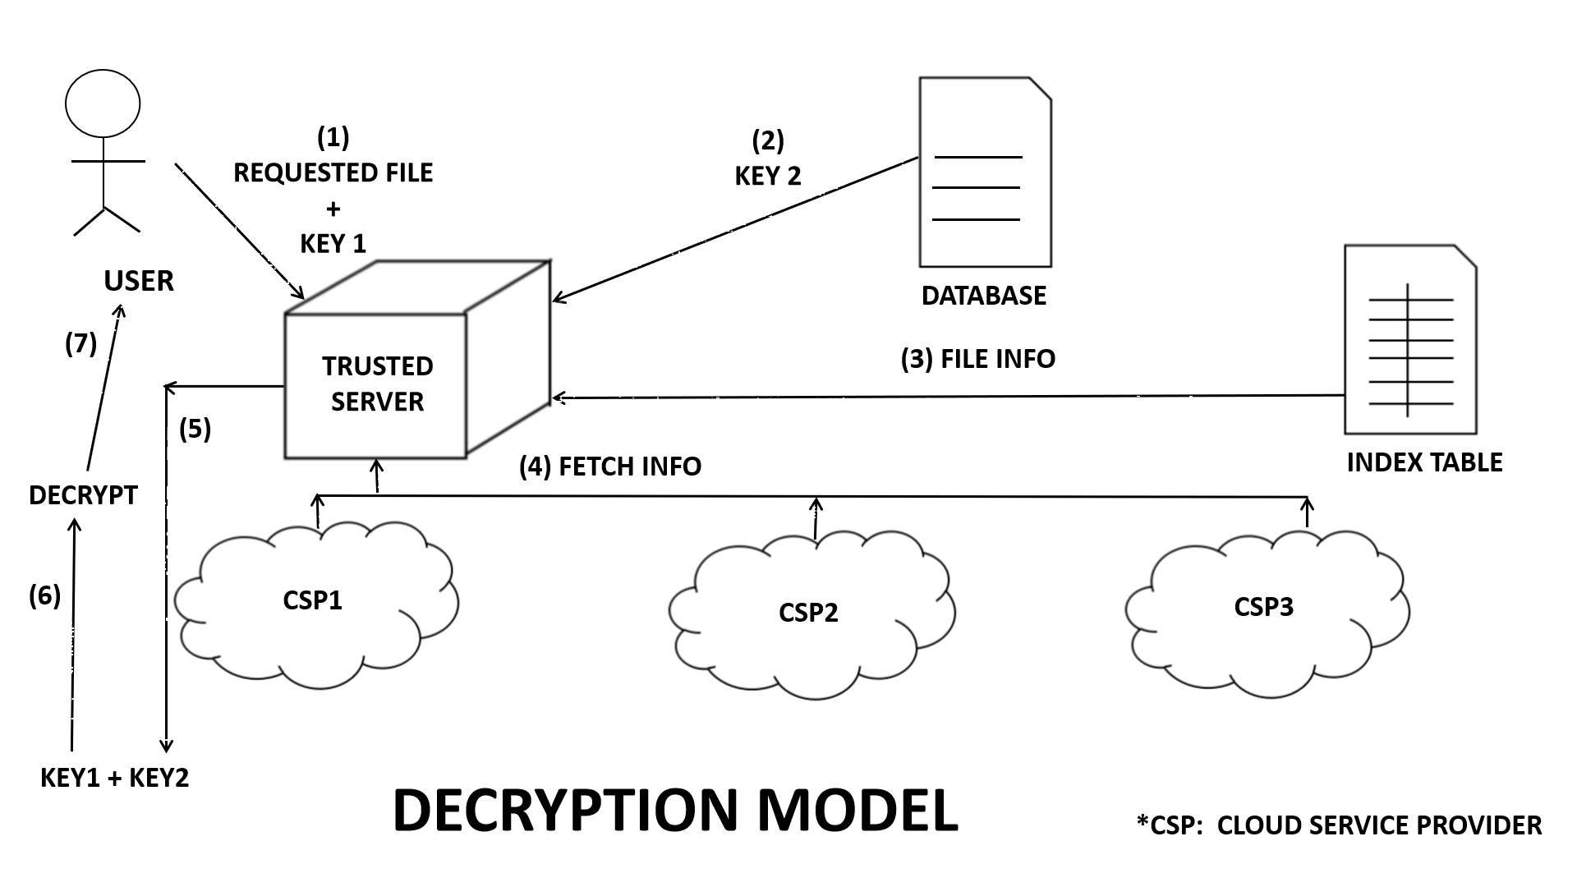

Slide 10
Decryption Model
The user needs to access or download the file stored in the IaaS cloud layer.
The user will request for the file to the trusted server. The trusted server checks for the user id . If present, it will request the user for the filename and key1.
The requested filename is searched in the indexing table.
All the information corresponding to the requested filename is retrieved from the indexing table, the location of different slices and key2 for decryption.
Every slice is fetched and merged to form the complete encrypted file.
Using key1 and key2, the file decrypted and delivered to the user.

Slide 11
Encryption Mechanism
PlainText
Convert each character to ASCII
Convert ASCII to Binary
Add redundancy bits to make it palindrome
Convert binary bits to decimal format
Apply Rabin encryption to that decimal number
Convert the Rabin encrypted decimal number to 13 bit binary
Write the ciphertext to the file which is to be stored.

Slide 12
Decryption Mechanism
CipherText
Get 13 bits
Convert to Decimal
Apply Euclid Algorithm to get 4 roots
Identify the correct root using redundancy bits
Convert the root to binary
Remove the redundancy bits (i.e. the second half)
The decimal of those bits is the ASCII code for the character

Slide 13
RABIN Cryptosystem.
Encryption-
Ciphertext = m² mod n where, m=plain text n=public key
Decryption-
Plaintext = √c mod n
Roots-
r = c^{(p+1)/4} mod p
s= c^{(q+1)/4} mod q where, p, q= private keys
x= (a*p*s+b*q*r) mod n
y= (a*p*s-b*q*r) mod n
Euclid algorithm- a * p + b * q = 1

Slide 14
CONCLUSION AND FUTURE WORK
This project focuses on improved confidentiality technique where two private keys are used, one key is user specific and common for all files and the other key is unique for all files. This ensures data portability.
The data is sliced into 3 parts after encryption, which provides additional security. This ensures data loss recovery to a great extent.
The sliced data parts are rearranged and combined in such a way that 66.67% of the complete data is present in each node ensuring data availability.
This model can be implemented for more than 3 cloud service providers.
It can be implemented for media files like images, audio, video etc too.
This model can be modified for multiple cloud service provider failure.

Slide 15
THANK
YOU

